Slide 1


Join at slido.com #3436682
ⓘ Start presenting to display the joining instructions on this slide.

Slide 2
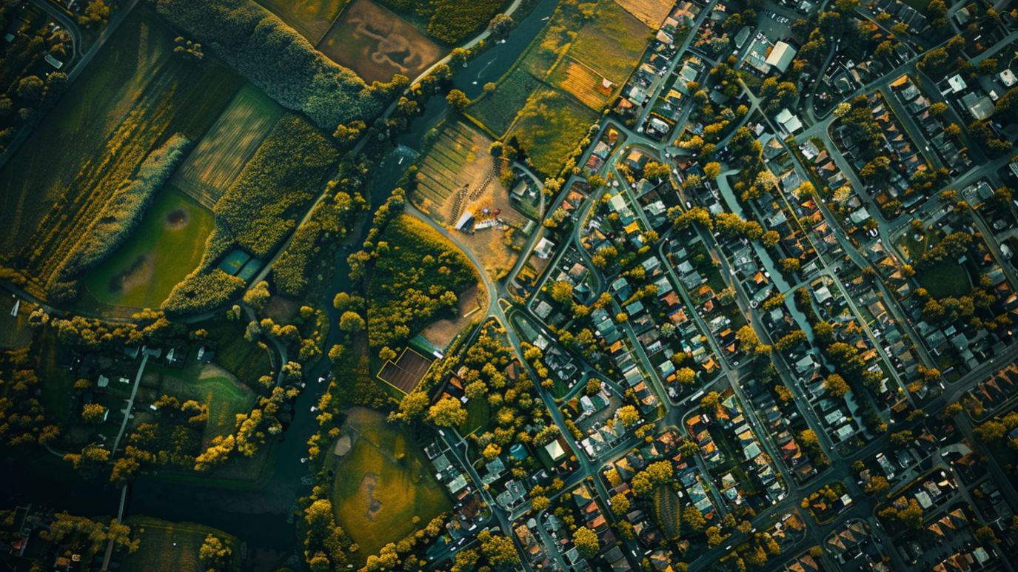
Clearing the Air: Unveiling Insights on Health Through Data Analysis

Slide 3
THE Process
Data and Process

Slide 4
OpenWeatherMap Air Pollution API
Global Health Data Exchange
Australian Bureau of Statistics (2021) Regional Population
API NINJAS
Study Objective:
Analyse key air pollution metrics at varying scales and over different timeframes to evaluate impact on public health and wellbeing.
Collation
Cleaning
2
Data Preparation
Descriptive Stats
1
Define
3
Exploratory Data Analysis
Graphical Stats
Input: Hypothesis
6
Review &
Feedback
4
Interpretation & Validation
5
Conclusions
Output: Reporting

Slide 5

 |  | SO₂ | NO₂ | PM₁₀ | PM_{2.5} | O₃ | CO
 |  | Concentration in μg/m³
Good | 1 | [0; 20) | [0; 40) | [0; 20) | [0; 10) | [0; 60) | [0; 4400)
Fair | 2 | [20; 80) | [40; 70) | [20; 50) | [10; 25) | [60; 100) | [4400; 9400)
Moderate | 3 | [80; 250) | [70; 150) | [50; 100) | [25; 50) | [100; 140) | [9400-12400)
Poor | 4 | [250; 350) | [150; 200) | [100; 200) | [50; 75) | [140; 180) | [12400; 15400)
Very Poor | 5 | ⩾350 | ⩾200 | ⩾200 | ⩾75 | ⩾180 | ⩾15400
Not included in the Air Quality Index: Nitrogen monoxide (NO) and Ammonia (NH₃)
Pollutants

Slide 6

LET’S HAVE SOME FUN
HYPOTHESES Q&A

Slide 7

The greater the population size, the higher the recorded pollution in a town or city.
ⓘ Start presenting to display the poll results on this slide.
Notes:
Alvin

Slide 8

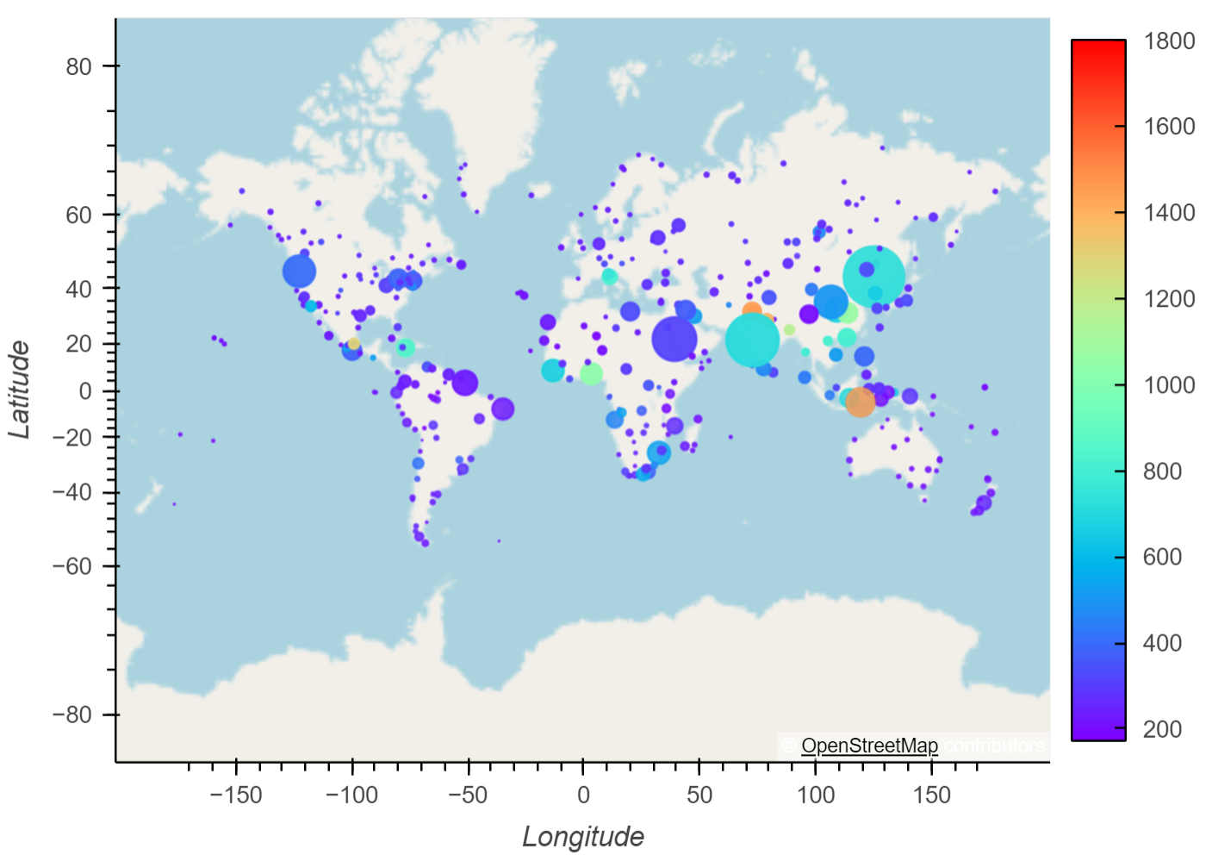
Global Winter CO Pollution Levels in μg/m by Population
Q&A - Population versus Pollution - Global
Notes:
Global Pollution Map: This map shows higher concentrations of pollution (represented by warmer colours) corresponding with larger population areas (denoted by bubble size). This visual correlation supports the hypothesis that more populous areas tend to have higher pollution levels.

Slide 9
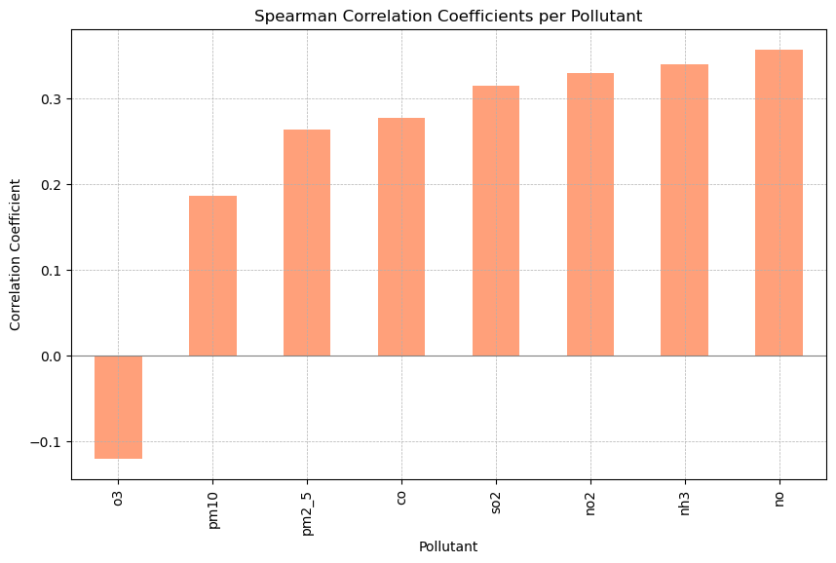
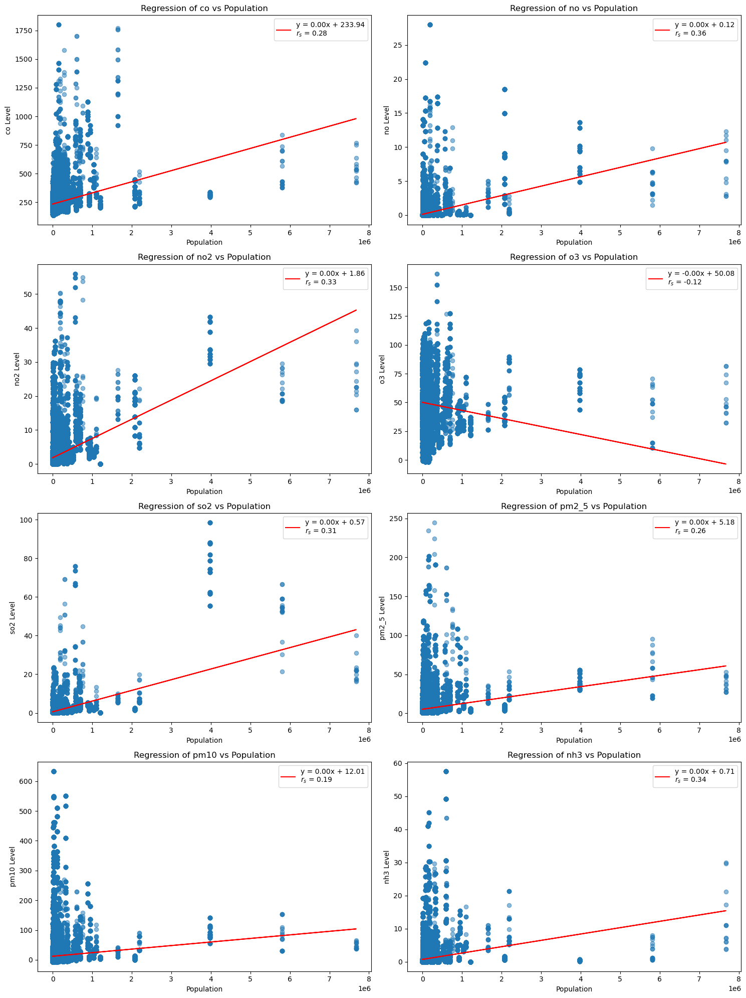
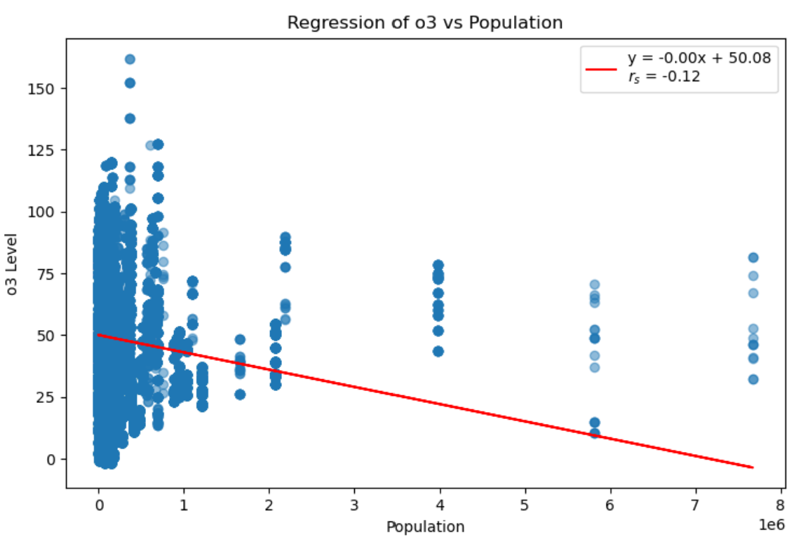
Nitrogen Monoxide
Ozone
Q&A - Population versus Pollution - Global
Notes:
Spearman Correlation Coefficients: The bar graph shows a negative correlation for ozone with population (𝑟𝑠=−0.12) and positive correlations for other pollutants. This suggests that except for ozone, higher population sizes generally correlate with increased pollution levels, supporting the hypothesis.

Slide 10
Higher population densities are associated with higher air pollution levels in Australian towns and cities.
ⓘ Start presenting to display the poll results on this slide.

Slide 11

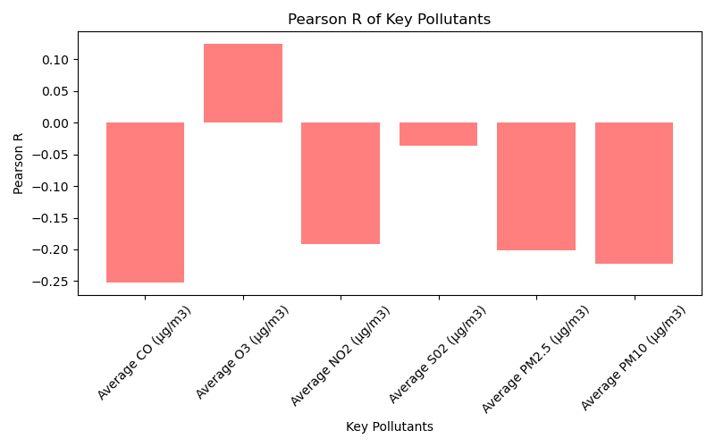
Q&A - Population versus Pollution – Local (Australia)
Notes:
Lower population density: fewer sources of pollution per square km
Stringent environmental regulations: help to reduce emissions of air pollutants and improve air quality.
Geographic factors: Vast open spaces, prevailing winds, rainforest etc.
Low levels of industrial activity: fewer industrial sources of pollution

Slide 12
Globally pollutant levels vary significantly across the four season.
ⓘ Start presenting to display the poll results on this slide.

Slide 13
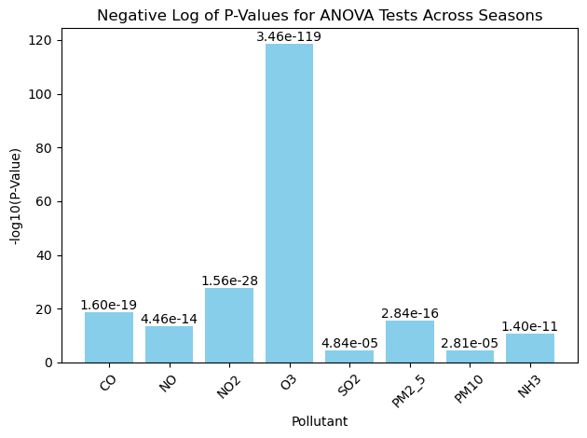
Q&A - Pollutant Levels By Season
Notes:
Population and Pollution: Higher population densities tend to increase levels of nitrogen oxides and particulate matter.
Ozone Behavior: Ozone levels often decrease when other pollutants increase, indicating complex chemical interactions.
Seasonal Impact: The relationship between population and pollutants varies slightly with the seasons, showing how weather and activities influence air quality.

Slide 14

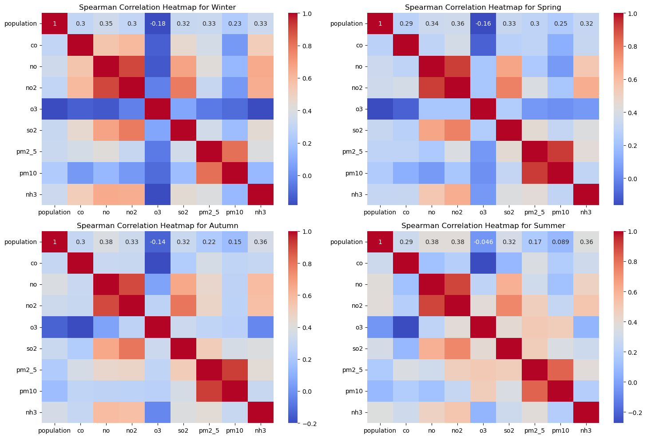
Autumn
Winter
Summer
Spring
Q&A - Pollutant Levels By Season
Notes:
Population and Pollution: Higher population densities tend to increase levels of nitrogen oxides and particulate matter.
Ozone Behavior: Ozone levels often decrease when other pollutants increase, indicating complex chemical interactions.
Seasonal Impact: The relationship between population and pollutants varies slightly with the seasons, showing how weather and activities influence air quality.

Slide 15
Higher levels of air pollutants correlate with higher occurrences of depressive disorders.
ⓘ Start presenting to display the poll results on this slide.

Slide 16
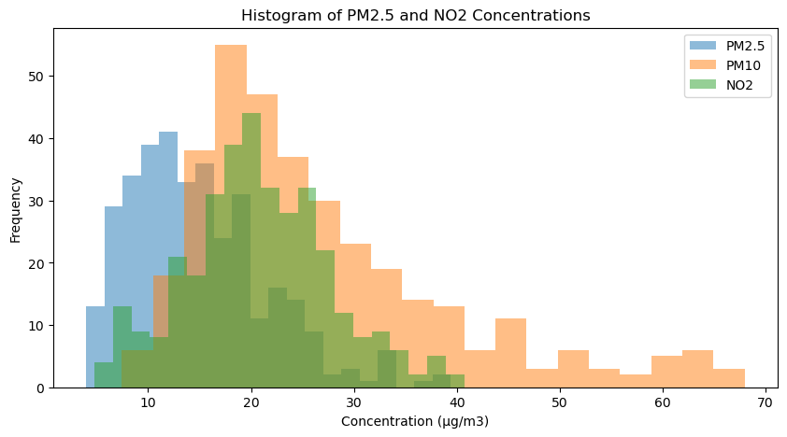
Q&A – Pollution Versus Depression

Slide 17

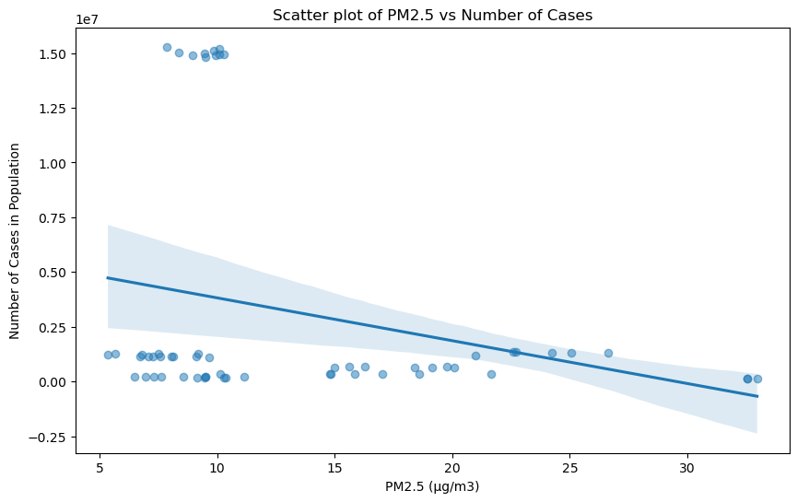
Correlation Coefficient: -0.26
Q&A – Pollution Versus Depression

Slide 18
Which air pollutant has the most significant correlation to respiratory deaths?
ⓘ Start presenting to display the poll results on this slide.

Slide 19

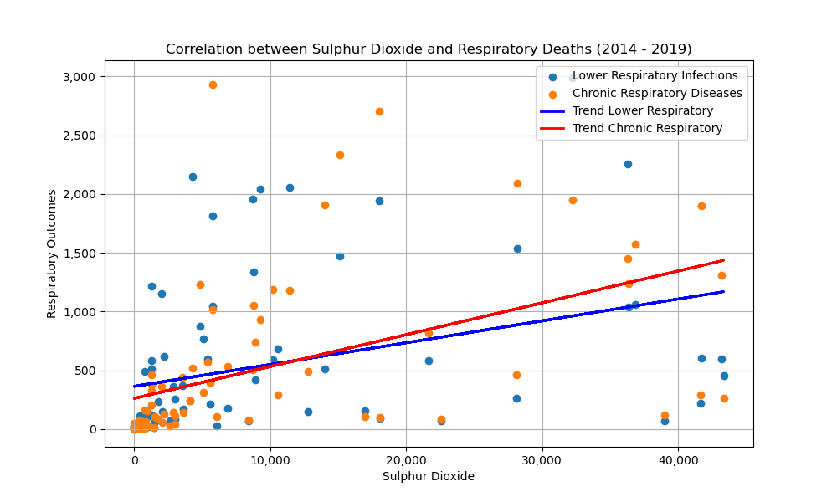
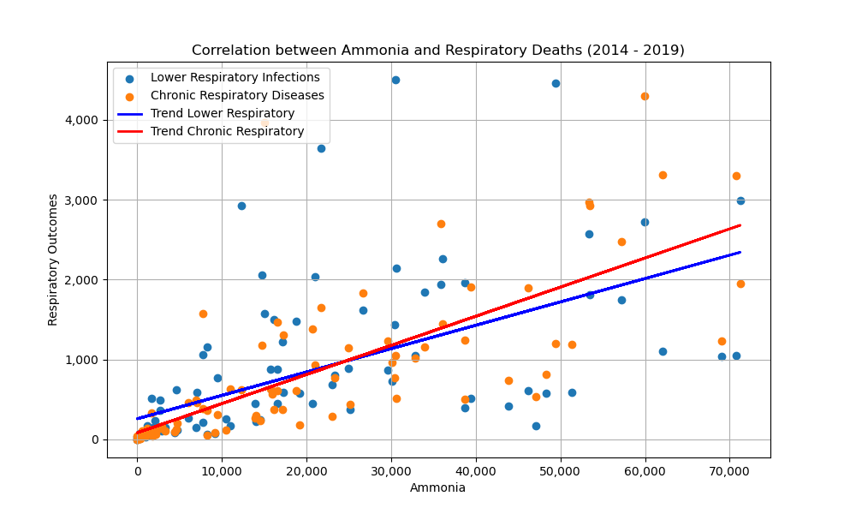
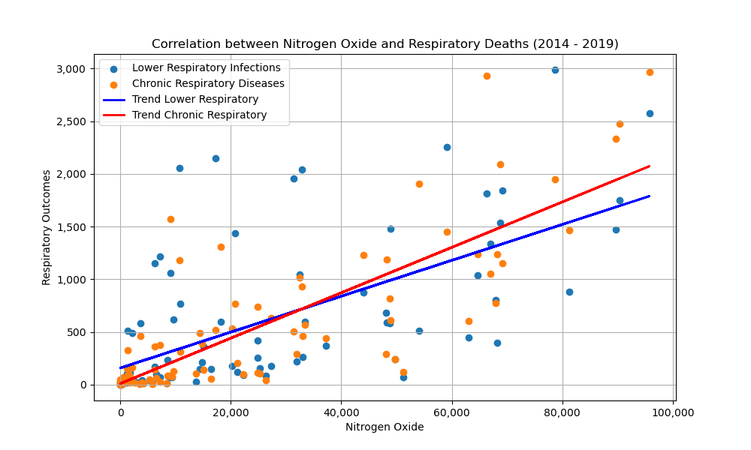
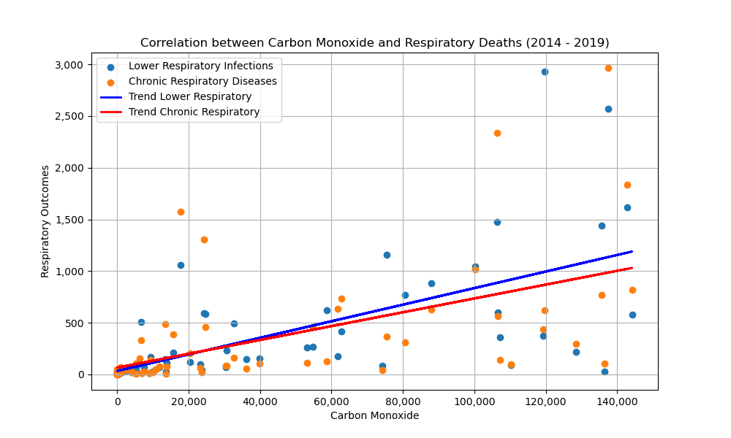
Sulphur Dioxide
Ammonia
Nitrogen Monoxide
Carbon Monoxide
Q&A – Pollution Versus Depression

Slide 20
CONCLUSIONS
So, What are Our Thoughts?

Slide 21
Conclusion
Limitations
1
Population v Pollution Levels
=
Correlation (Global)
≠
Weak Correlation (Australia)
Timeframe (2 years)
Socio-economic considerations
2
Pollution Level Means Vary by Season
Timeframes (2 years)
Consistency of reporting and analysis across countries
Conclusions & Limitations

Slide 22
Conclusion
Limitations
3
Air Pollution v Depressive Mental Health Disorders
=
Inconclusive (more study needed)
Data collection bias
Consistency of reporting
4
Air Pollution v Respiratory Deaths
=
Significant Correlation
Ecological fallacy
Correlation ≠ Causation
Conclusions & Limitations

Slide 23

QUESTIONS?

